Slide 1
Interactive Data Visualization
Part 1

Slide 2
Main Code
plot_ly(data = dataframe, x = ~name_of_variable1,
y = ~name_of_variable2,
color = ~name_variable3,
symbol = ~name_variable3,
type = "", mode = "",
colors = pallete_vector)

Slide 3
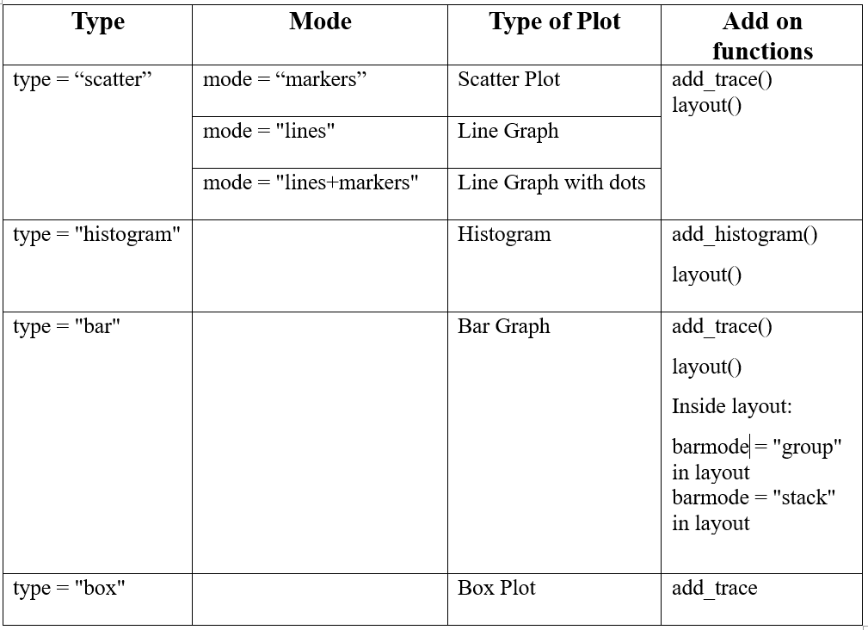

Slide 4
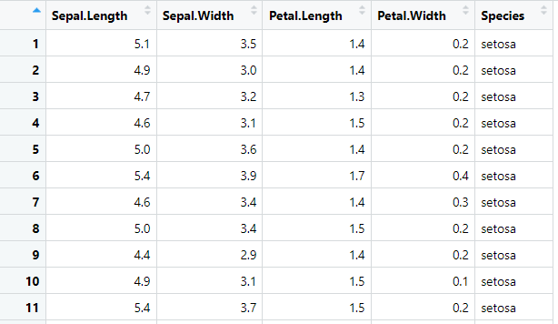
Dataset: Iris

Slide 5
Scatter Plots with Plotly

Slide 6
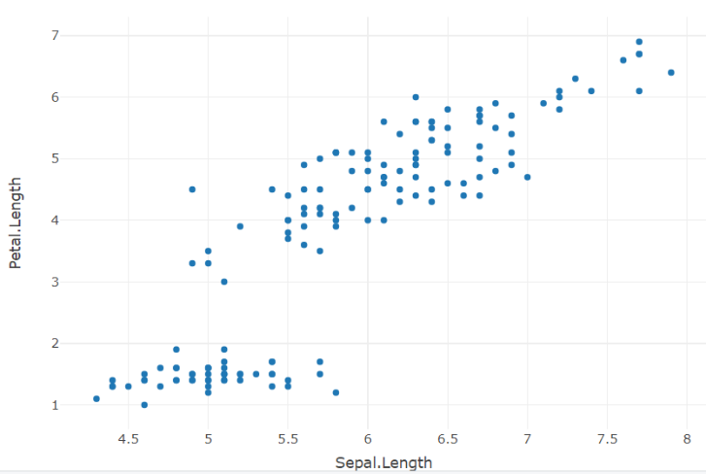
Simple Scatter Plot
fig1 <- plot_ly(data = iris, x = ~Sepal.Length, y = ~Petal.Length,
type = "scatter", mode = "markers")
fig1

Slide 7
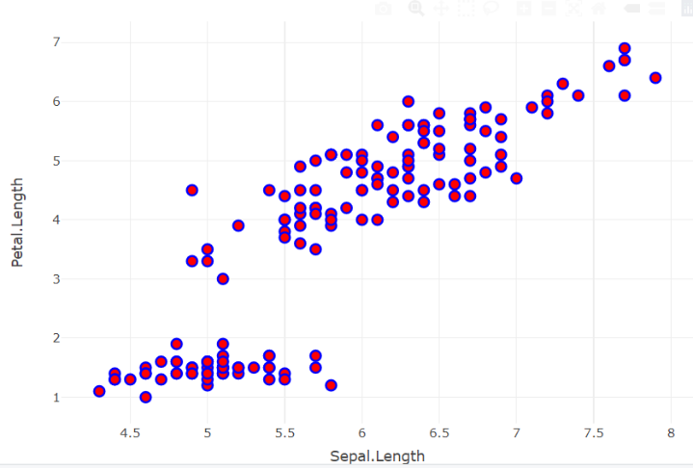
Stylish Dots
fig2 <- plot_ly(data = iris, x = ~Sepal.Length, y = ~Petal.Length,
type = "scatter", mode = "markers",
marker = list(size = 10,
color = "red",
line = list(color = "blue",
width = 2)))
fig2

Slide 8
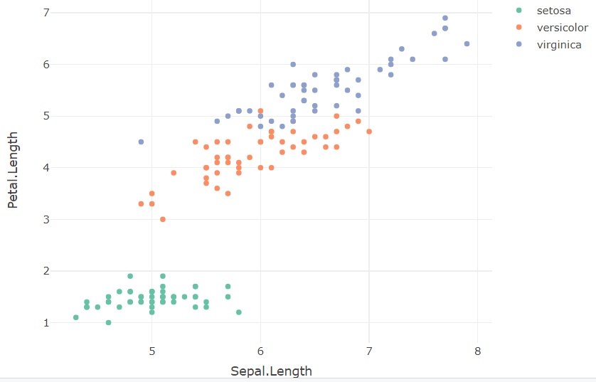
Three Variables
fig3 <- plot_ly(data = iris, x = ~Sepal.Length, y = ~Petal.Length,
color = ~Species,
type = "scatter", mode = "markers")
fig3

Slide 9
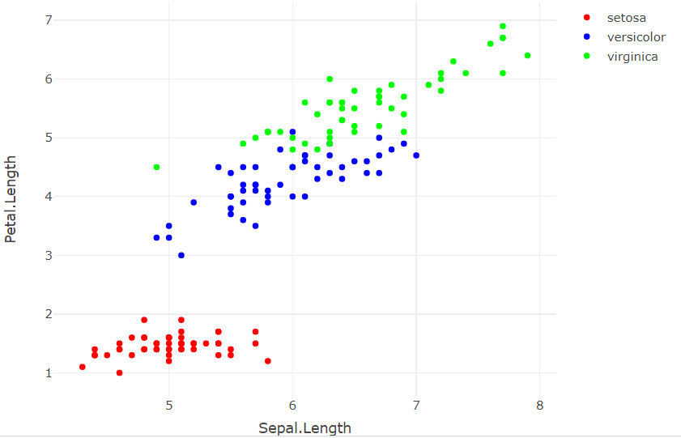
Manually Change the Colors for the Third Variable
fig4 <- plot_ly(data = iris, x = ~Sepal.Length, y = ~Petal.Length,
color = ~Species,
type = "scatter", mode = "markers",
colors = c("red", "blue", "green"))
fig4

Slide 10
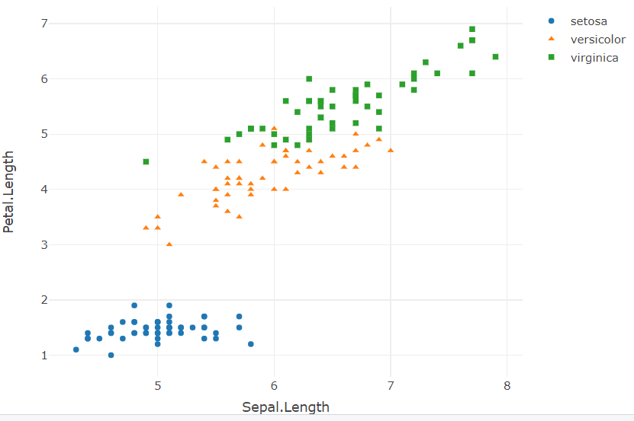
Symbols
fig5 <- plot_ly(data = iris, x = ~Sepal.Length, y = ~Petal.Length,
symbol = ~Species,
type = 'scatter', mode = 'markers')
fig5

Slide 11
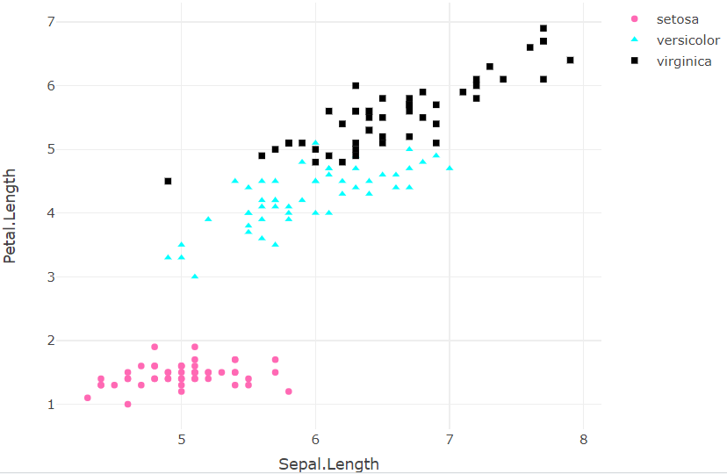
Changing the colors of the symbols.
fig6 <- plot_ly(data = iris, x = ~Sepal.Length, y = ~Petal.Length,
symbol = ~Species,
color = ~Species,
type = 'scatter', mode = 'markers',
colors = c("hotpink", "cyan", "black"))
fig6

Slide 12
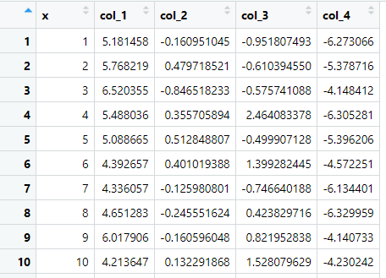
Dataset: dummy_data_1

Slide 13
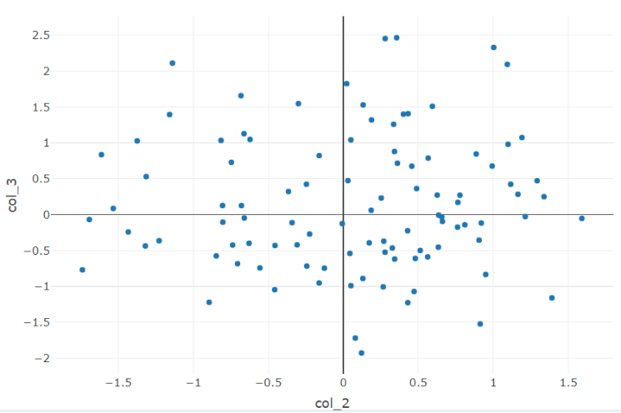
Layout (titles, background...etc)
Figure without layout
fig_7 <- plot_ly(data = dummy_data_1, x = ~col_2, y = ~col_3,
type = "scatter", mode = "markers")
fig_7

Slide 14
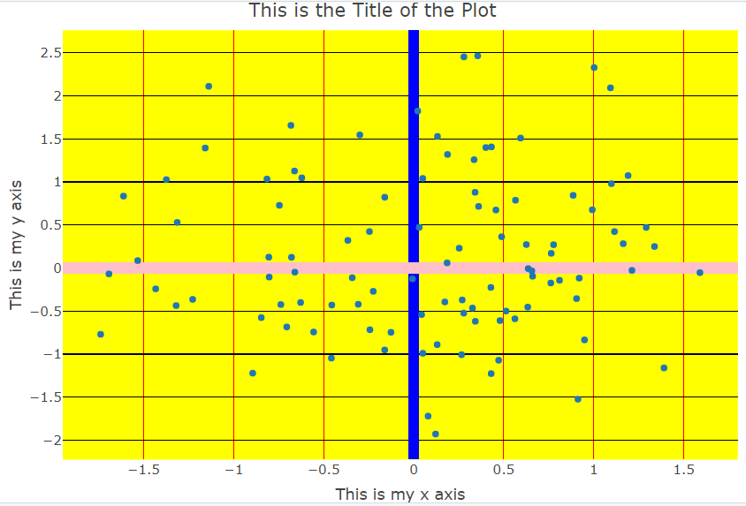
Figure with layout
fig8 <- plot_ly(data = dummy_data_1, x = ~col_2, y = ~col_3,
type = "scatter", mode = "markers") %>%
layout(title = "This is the Title of the Plot",
legend = list(title=list(text="Legend Title")),
plot_bgcolor="yellow",
xaxis = list(
title = "This is my x axis",
zerolinecolor = "blue",
zerolinewidth = 10,
gridcolor = "red"),

Slide 15
yaxis = list(
title = "This is my y axis",
zerolinecolor = "pink",
zerolinewidth = 10,
gridcolor = "black"))
fig8

Slide 16
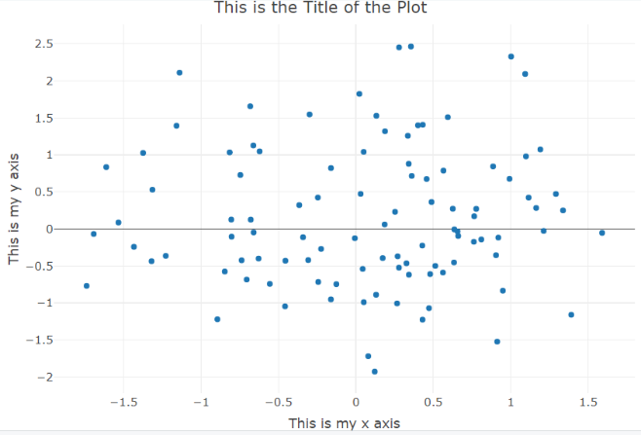
Figure with layout (zeroline)
fig9 <- plot_ly(data = dummy_data_1, x = ~col_2, y = ~col_3,
type = "scatter", mode = "markers") %>%
layout(title = "This is the Title of the Plot",
xaxis = list(
title = "This is my x axis",
zeroline = FALSE),
yaxis = list(
title = "This is my y axis"))
fig9

Slide 17
Line Plots

Slide 18
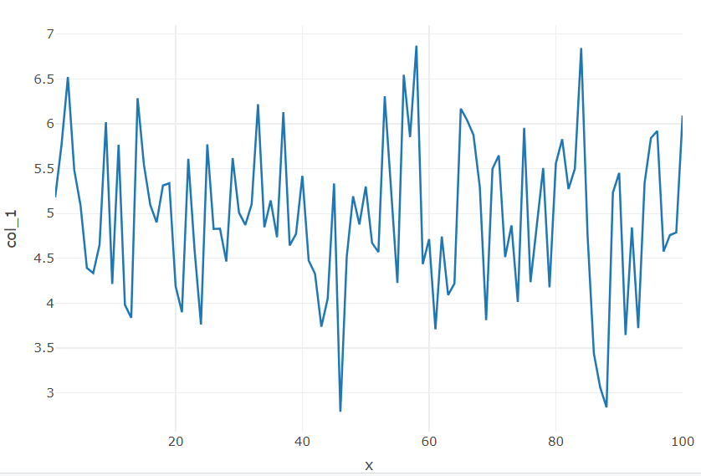
Simple Line Plot
fig10 <- plot_ly(data = dummy_data_1, x = ~x, y = ~col_1,
type = "scatter", mode = "lines")
fig10

Slide 19
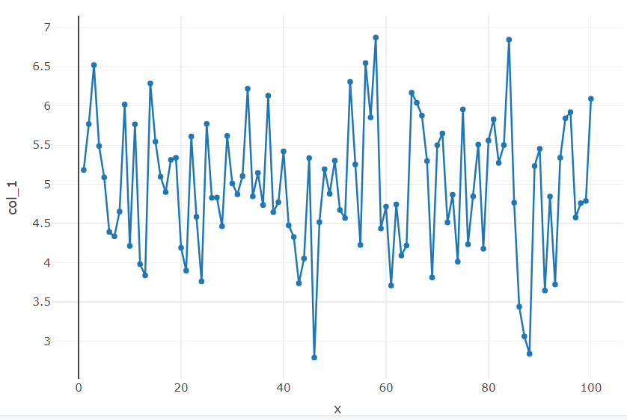
Line Plot with Markers
fig11 <- plot_ly(data = dummy_data_1, x = ~x, y = ~col_1,
type = "scatter", mode = "lines+markers")
fig11

Slide 20
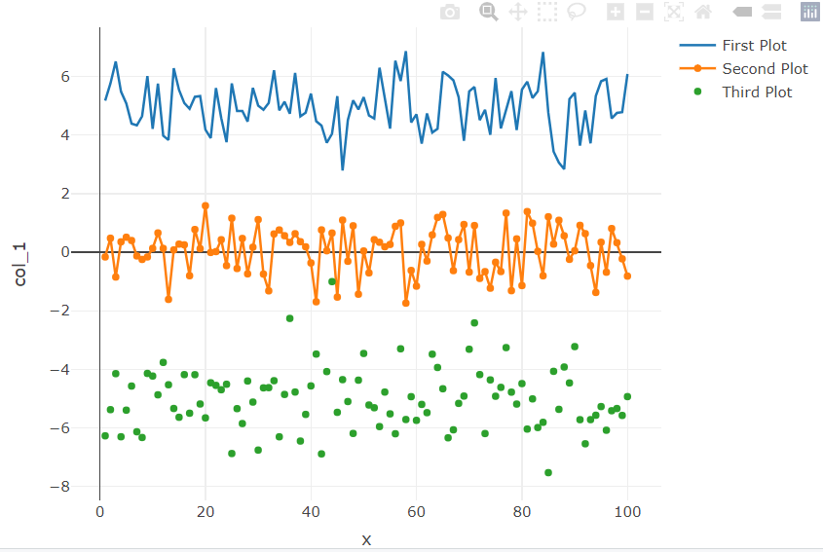
Combining Multiple Plots
fig12 <- plot_ly(data = dummy_data_1, x = ~x, y = ~col_1,
name = "First Plot",
type = "scatter", mode = "lines") %>%
add_trace(y = ~col_2, name = "Second Plot",
type = "scatter", mode = "lines+markers") %>%
add_trace(y = ~col_4, name = "Third Plot",
type = "scatter", mode = "markers")
fig12

Slide 21
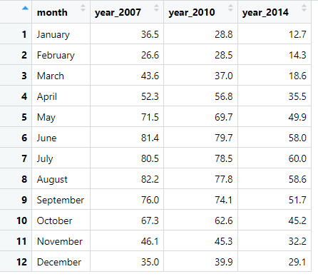
Dataset: dummy_data_2

Slide 22
Style- Multiple Line Plot
fig13 <- plot_ly(dummy_data_2, x = ~month, y = ~year_2010, name = "Year 2010",
type = "scatter", mode = "lines",
line = list(color = "red", width = 4))%>%
add_trace(y = ~year_2014, name = "Year 2014",
type = "scatter", mode = "lines",
line = list(color = "blue", width = 4, dash = "dot")) %>%
add_trace(y = ~year_2007, name = "Year 2007",
type = "scatter", mode = "lines",
line = list(color = "green", width = 4, dash = "dash")) %>%
layout(title = "Average High and Low Temperatures in New York",
xaxis = list(title = "Months"),
yaxis = list (title = "Temperature (degrees F)"))

Slide 23
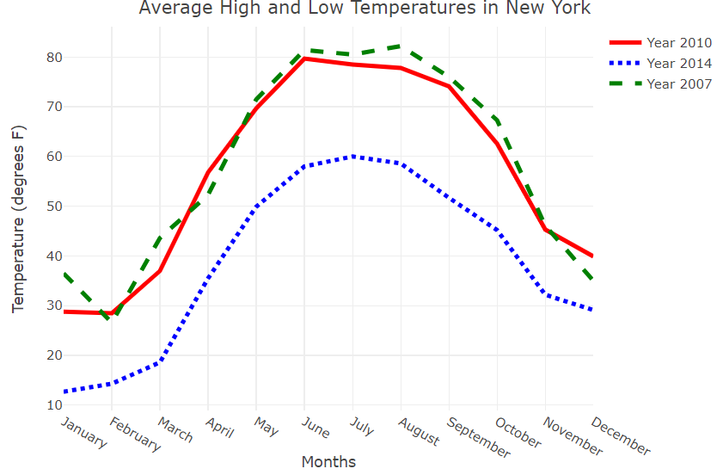

Slide 24
Combining ggplot2 with Plotly
You can enhance static ggplot2 plots with interactivity by using ggplotly(). The ggplotly() function is used to convert the ggplot plot to a Plotly interactive plot.
fig14 <- dummy_data_1 %>%
ggplot(aes(x = col_1, y = col_2))+
geom_point()
fig14
ggplotly(fig14)
Note: See this plot on R

